Slide 1
Faster R-CNN: Towards Real-Time Object Detection with Region Proposal Networks
Name: Sameer Sadman Chowdhury
ID: 23341118

Slide 2
Introduction and Purpose
What is Faster R-CNN ?
An object detection model
What is Region Proposal Networks (RPN) ?
A fully convolutional network

Slide 3
Need for efficient and accurate object detection
A unified deep learning based network
More efficient and effective approach

Slide 4
Contribution

Slide 5
Intro to RPN
Unified Framework for Object Detection
End to End Training of RPN
Real-Time Object Detection

Slide 6
Related Work

Slide 7
Selective Search
Region-based CNNs
OverFeat
MultiBox
DeepMask
Efficient Visual Recognition

Slide 8
Methodology

Slide 9
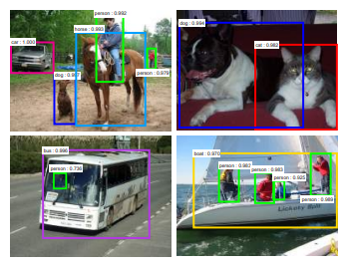
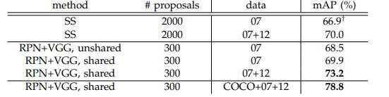
Pascal VOC 2007 test set

Slide 10
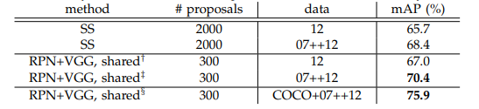
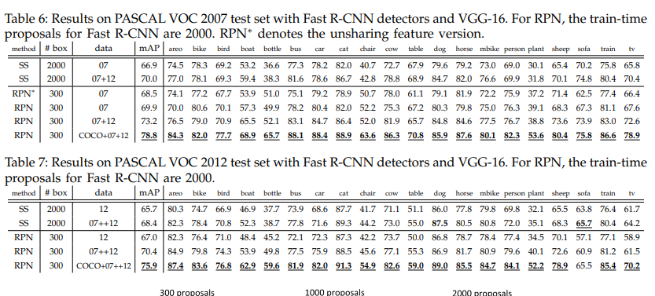
Pascal VOC 2012 test set

Slide 11
Limitations
Focused on 2D object detection, not 3D
Assumes that the images are preprocessed
No detailed analysis of the computational requirements
May not generalize well to other datasets

Slide 12
Future Work
Improvements in Speed and Efficiency
Robustness and Generalization
3D Object Detection
Real-Time Applications
Semi-Supervised and Unsupervised Learning
Integration with Multi-Modal Data
Adversarial Robustness
Scalability
Cross Domain Object Detection
Interpretability

Slide 13
Thank You

